Slide 1


WICKED ADVENTURES
Guided by:
Dr. Paul Greaney
Presented by:
Anup Jacob (L00163455)
Muhammed Shafeeq Thottathil
Sreejith Jayasree Purushothaman
Snehal Khairnar
Snehal Sudhakar Shirsath
Varnit Rohilla
DEVOPS PROJECT MANAGEMENT TEAM ASSIGNMENT
APRIL 2022

Slide 2
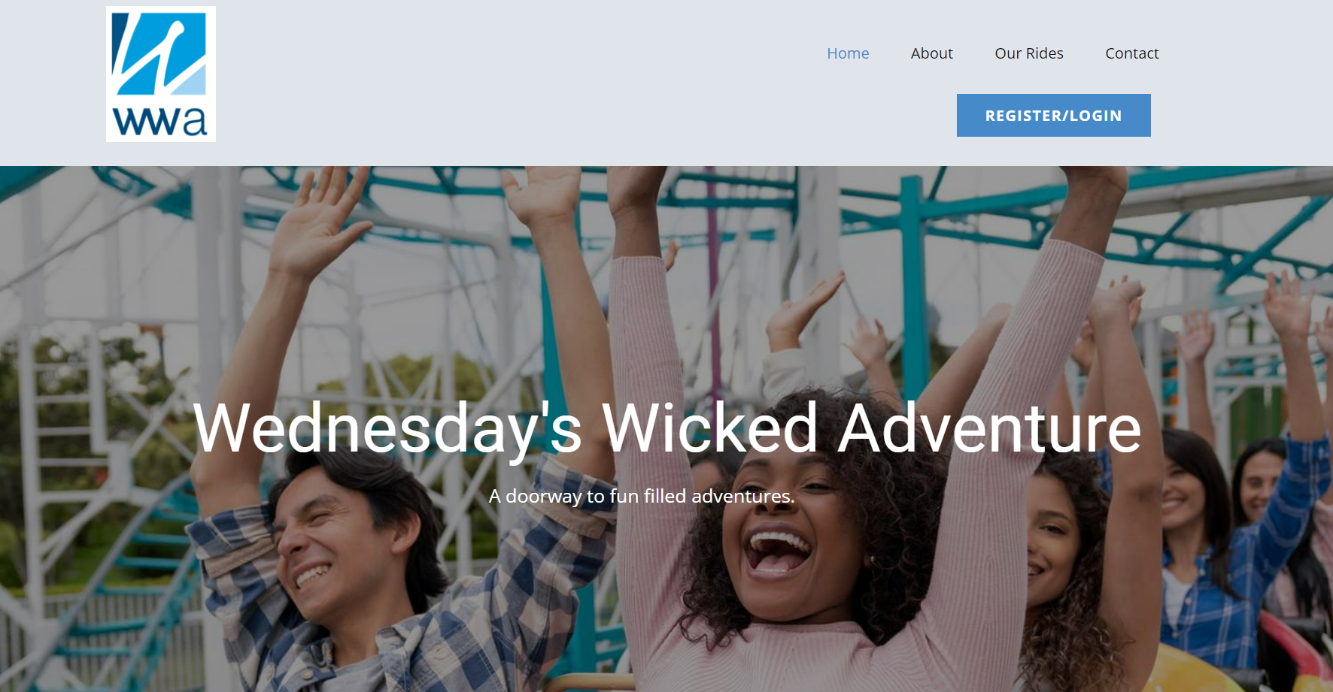
INTRODUCTION
Web Application for Project – Wednesday’s Wicked Adventures.
Online booking system for an adventure theme park.
Customers needs to register and signup for booking.
Web application created in DevOps workflow.
WEDNESDAY’S WICKED ADVENTURES
APRIL 2022

Slide 3
APPLICATION
WEDNESDAY’S WICKED ADVENTURES
APRIL 2022

Slide 4

Flask web framework
HTML – Standard Mark up Language used for creating web documents.
CSS – Describes the presentation properties of the web document written in HTML format. Includes Layouts, fonts, colors, etc.
Website builder tool partly used for easy webpage creation with better design, looks and functionality - nicepages.
Development and testing for each page implemented before integrating with python.
Static IP address used for accessing the HTML webpages run via app.py.
Issues found during testing were added to JIRA.
WEDNESDAY’S WICKED ADVENTURES
APRIL 2022

Slide 5

HTML and CSS
HTML – Standard Mark up Language used for creating web documents.
CSS – Describes the presentation properties of the web document written in HTML format. Includes Layouts, fonts, colors, etc.
Website builder tool partly used for easy webpage creation with better design, looks and functionality - nicepages.
Development and testing for each page implemented before integrating with python.
Static IP address used for accessing the HTML webpages run via app.py.
Issues found during testing were added to JIRA.
WEDNESDAY’S WICKED ADVENTURES
APRIL 2022

Slide 6

DATABASE
Database used – MySQL.
Initial development and testing done in Local DB.
Database used to store the customer data and connect the Front-end (HTML) for access.
Third party tools used to develop and run the queries including SQL workbench.
Pre-requisites – Installation of MySQL Server.
Higher environment testing done in free and open-source MySQL hosting website configured by : https://www.freemysqlhosting.net.
WEDNESDAY’S WICKED ADVENTURES
APRIL 2022

Slide 7
GitHub for Repository
GitHub - Provider of Internet hosting for software development and version control using Git.
GitHub repository link for the project :
https://github.com/devopslecturer/awmsc2022.git.
Build, deployments and other tools are integrated into GitHub using “GitHub Actions” functionality.
YAML Files created and added to the ‘.github/workflows’ inside the repository.
WEDNESDAY’S WICKED ADVENTURES
APRIL 2022

Slide 8
TOOLS USED IN GITHUB ACTIONS
Docker.
Jmeter.
Pytest for Unit testing.
Snyk for security.
Sphinx for Autodocumentation.
WEDNESDAY’S WICKED ADVENTURES
APRIL 2022

Slide 9
ytest for unit testingest for unit testingor unit testing
2. PYTEST – UNIT TESTING
PyTest is a testing framework that allows users to write test scripts in Python.
It helps with the development of tests ranging from simple unit tests to large functional tests.
Pytest is very easy, open source and run the test in parallel manner.
Unit testing has been performed using PyTest.
Integration of PyTest in GitHub action using python application.
Details provided in the Git Wiki link in our repository. Click here.
WEDNESDAY’S WICKED ADVENTURES
APRIL 2022

Slide 10

5. SPHINX TOOL - AUTO DOCUMENTATION
An Open-source third party Tool used for auto documentation.
A documentation generator written in python language.
Implementation of Sphinx tool by creating YAML file using “GitHub Actions”.
Themes available in the URL below :
https://www.sphinx-doc.org/en/master/usage/theming.html
Details provided in the Git Wiki link in our repository. Click here.
Branch created for auto documentation – ‘gh-pages’ (Default).
WEDNESDAY’S WICKED ADVENTURES
APRIL 2022

Slide 11
GIT WIKI - USER GUIDES & INSTRUCTIONS
Platform provided by Git for adding documentation for the projects hosted in the GitHub repository.
Users can add and edit wiki pages directly on GitHub or locally using the command line.
GitHub repository for our project can be accessed using the link below.
URL: https://github.com/devopslecturer/awmsc2022/wiki
WEDNESDAY’S WICKED ADVENTURES
APRIL 2022

Slide 12
4. CONCLUSION
WEDNESDAY’S WICKED ADVENTURES
APRIL 2022

Slide 13

WEDNESDAY’S WICKED ADVENTURES
APRIL 2022

Slide 14

WEDNESDAY’S WICKED ADVENTURES
APRIL 2022

